Slide 1
APB PROTOCOL
Name: Shubhi Agrawal
Date: 13-06-2021

Slide 2
Content
AMBA Bus Architecture.
APB Interface Diagram.
Operation Of APB.
PIN Description.
Master Simulation Result.
APB Interface Diagram with two slaves.
Simulation Results of APB Protocol.

Slide 3
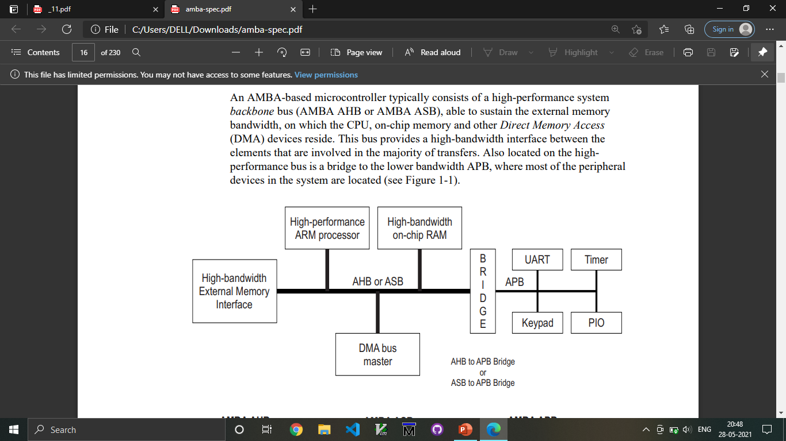
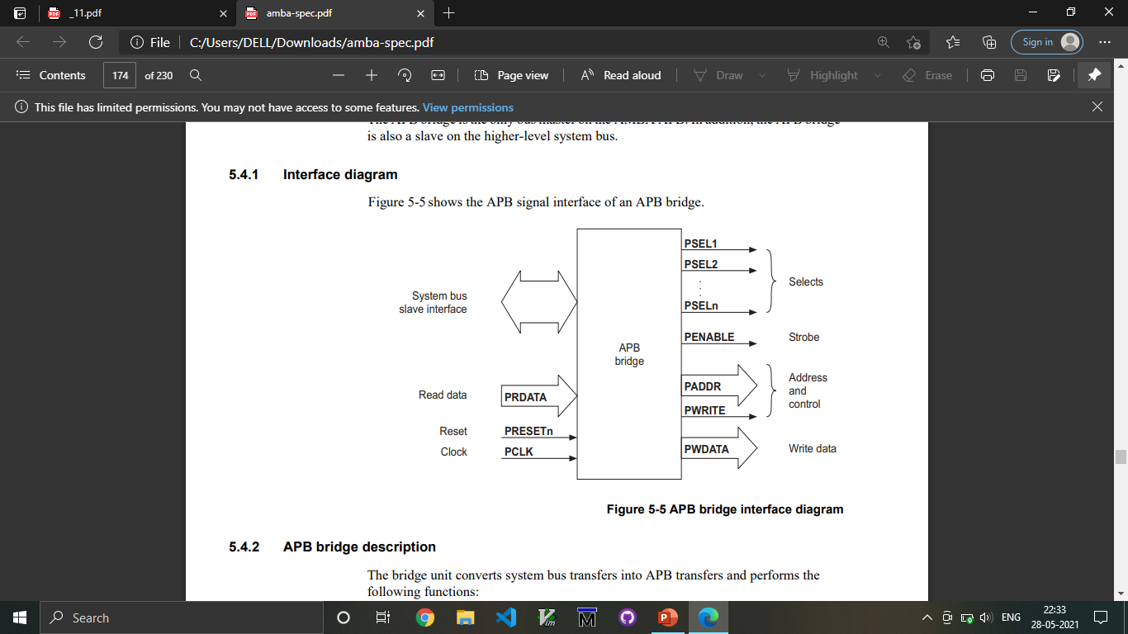
AMBA ARCHITECTURE

Slide 4
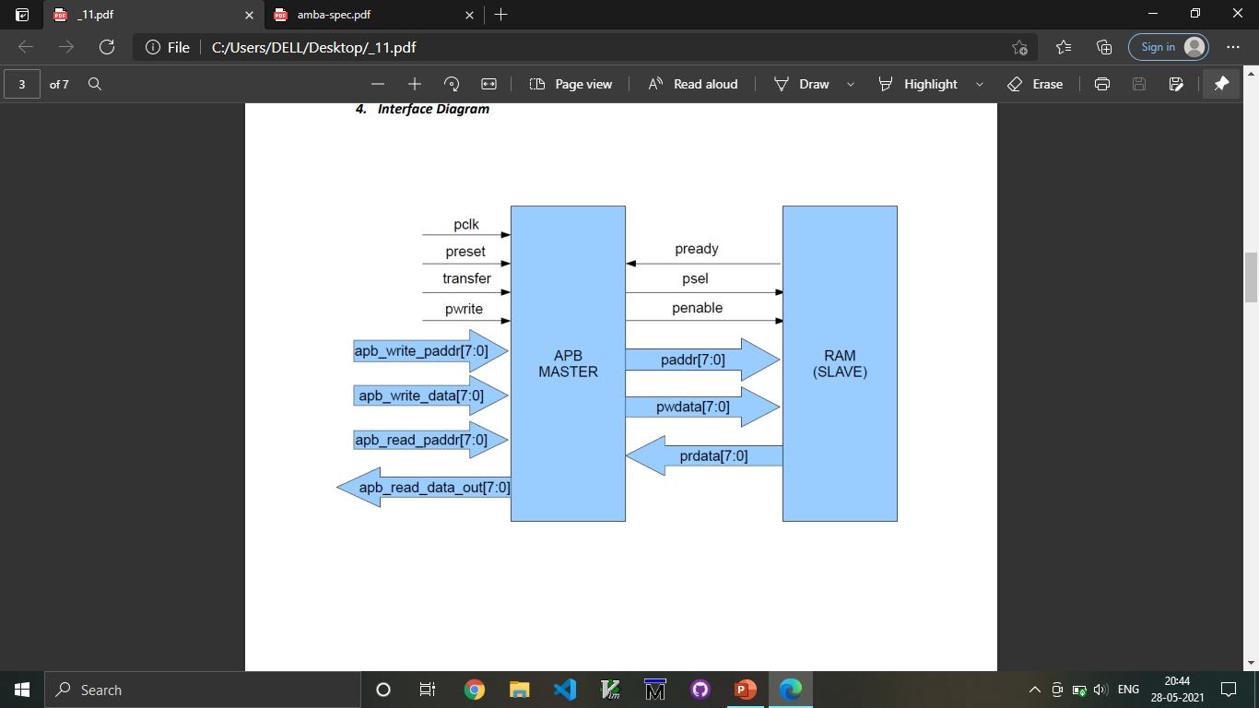
Interface Diagram
PCLK
PWRITE
PRESETn
PREADY
transfer
PSEL1
READ_WRITE
PENABLE
Dummy Signals

Slide 5
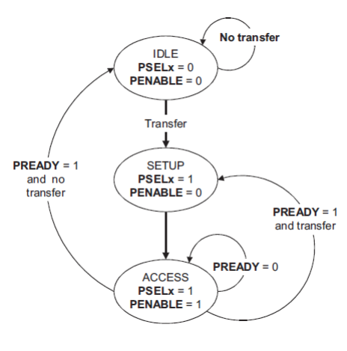
Operation of APB
IDLE
SETUP
ACCESS/ENABLE

Slide 6
PIN Description
SIGNAL | SOURCE | Description | WIDTH(Bit)
Transfer | System Bus | APB enable signal. If high APB is activated else APB is disabled | 1
PCLK | Clock Source | All APB functionality occurs at rising edge. | 1
PRESETn | System Bus | An active low signal. | 1
PADDR | APB bridge | The APB address bus can be up to 32 bits. | 8
PSEL1 | APB bridge | There is a PSEL for each slave. It’s an active high signal. | 1
PENABLE | APB bridge | It indicates the 2nd cycle of a data transfer. It’s an active high signal. | 1
PWRITE | APB bridge | Indicates the data transfer direction. PWRITE=1 indicates APB write access(Master to slave) PWRITE=0 indicates APB read access(Slave to master) | 1
PREADY | Slave Interface | This is an input from Slave. It is used to enter access state. | 1
PSLVERR | Slave Interface | This indicates a transfer failure by the slave. | 1
PRDATA | Slave Interface | Read Data. The selected slave drives this bus during read operation | 8
PWDATA | Slave Interface | Write data. This bus is driven by the peripheral bus bridge unit during write cycles when PWRITE is high. | 8

Slide 7
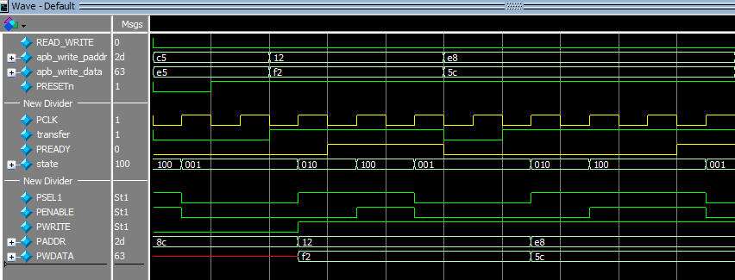
Master Write Operation
Write without wait state
Write with wait state
IDLE State
SETUP State
ENABLE State
IDLE State
SETUP State
ENABLE State
Input Signals
Output Signals

Slide 8
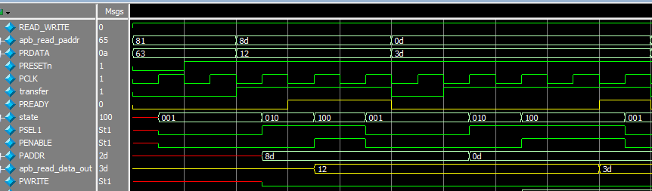
Master Read Operation
Read without wait state
Read with wait state
SETUP
State
ENABLE
State
IDLE State
IDLE State
SETUP State
ENABLE State
Input Signals
Output Signals

Slide 9
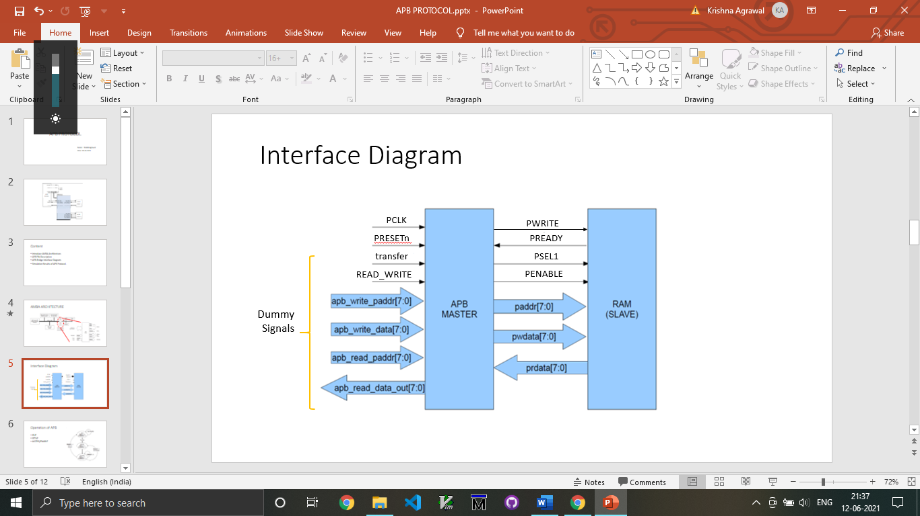
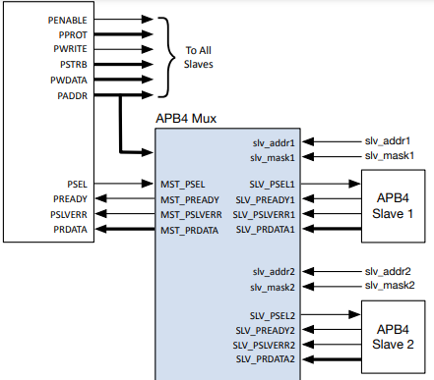
APB Interface with Slaves
APB Master
APB2
APB2

Slide 10
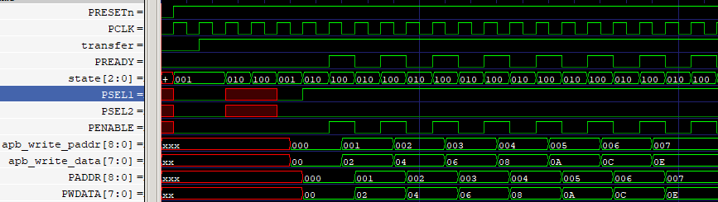
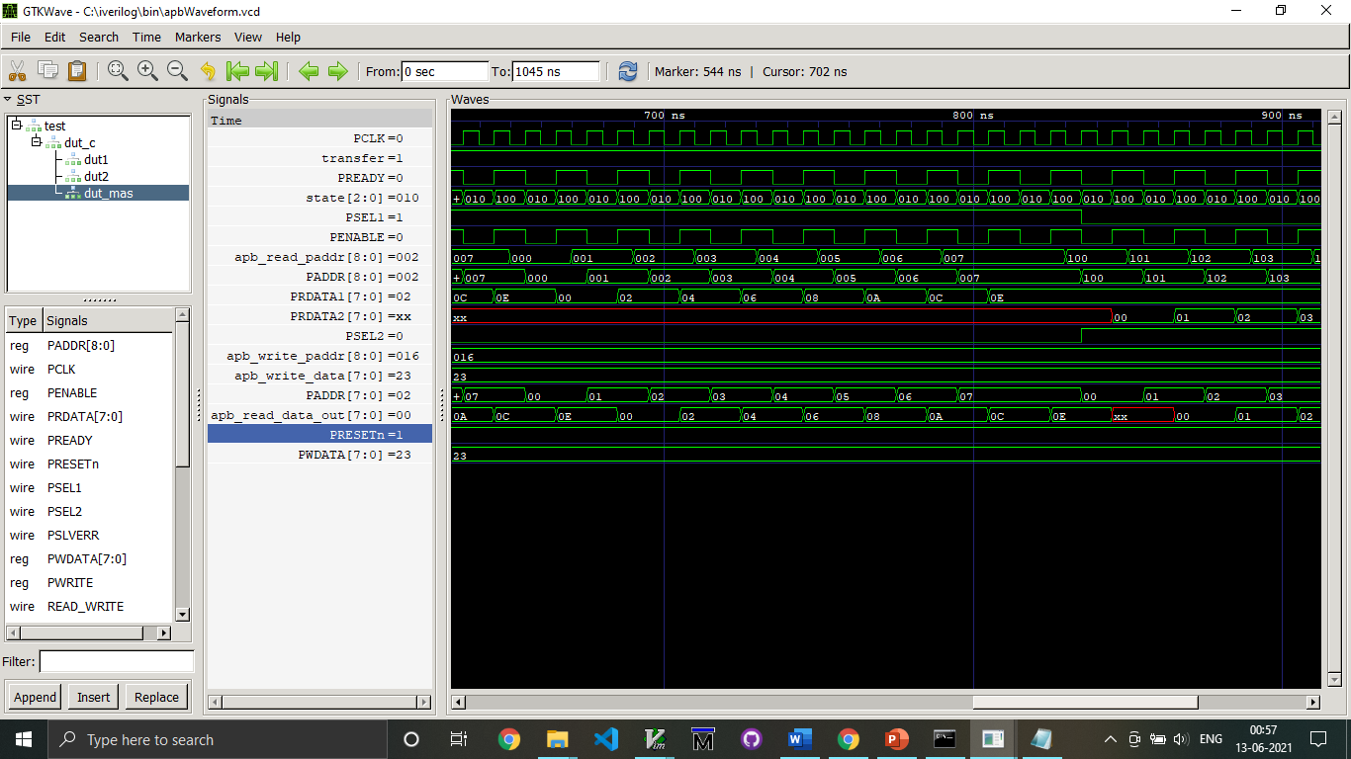
Read-Write Operation – Slave 1
Write
Operation
Read
Operation

Slide 11
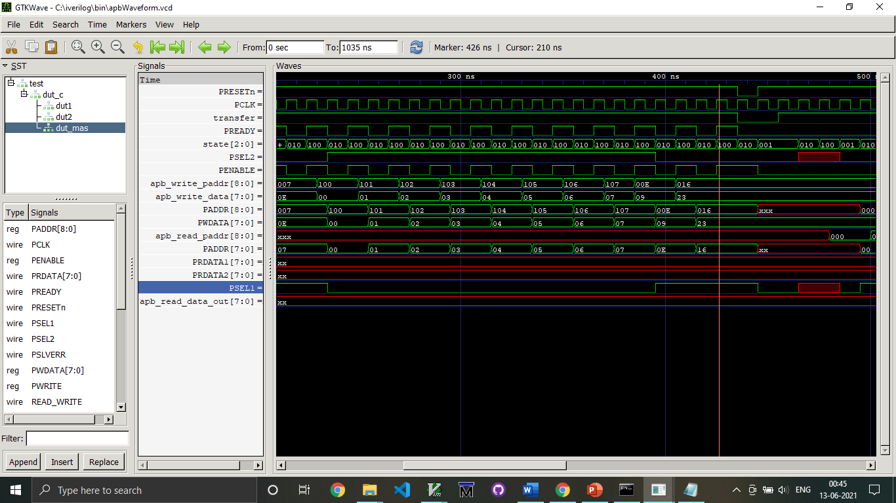
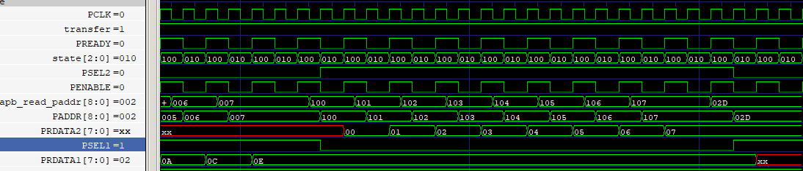
Read-Write Operation – Slave 2
Write
Operation
Read
Operation

Slide 12
Summary
Discussed about the APB Protocol.
Studied the simulation results of APB Protocol with two slaves.

